Slide 1
A Lightweight and Adaptive Logging Architecture
Diala Alazzeh 20210116
Jana Abdeen 20210507
Eyad Alssouqi 20200528
Supervised by: Prof Mohammad AlNabhan

Slide 2
Agenda
Introduction
Problem Statement
Comparison
Sequence Diagram
Architectural Design
Dashboard
Technology Stack
Scenario of Demonstration
Conclusion

Slide 3
Introduction
Log management and performance monitoring are essential components of modern IT systems, ensuring that organizations can maintain reliability, security, and operational efficiency. Logs act as a valuable source of information for diagnosing issues, monitoring performance, and identifying potential security threats. However, as systems grow in complexity, the challenges associated with log management and monitoring have increased.
Traditional logging systems often struggle with the massive volume of unstructured data generated by modern infrastructures. This creates issues in analysis, and timely delivery of log data. Additionally, monitoring systems face problems such as alert fatigue, where excessive false alarms can overwhelm teams, and real-time detection delays, which can result to inefficiencies.

Slide 4
Existing solutions like the ELK Stack (Elasticsearch, Logstash, and Kibana) have attempted to address these challenges. Logstash, for instance, is widely used for collecting, processing, and delivering logs. However, these systems are resource-intensive and require significant customization to handle complex, large-scale environments effectively. They often fail to provide cost-effective, scalable solutions for smaller organizations.

Slide 5
Problem Statement
1-Data Overload and Unstructured Logs
2-System Complexity
3-Lack of Centralized Logging and Delivery Issues
4-High cost of tools
5-Insufficient or Missing Log Information
6-Real-time Monitoring Challenges and False Alerts

Slide 6
Comparison
Feature | Traditional Logging Systems | Our Lightweight Logging Architecture
Log Format | Unstructured, heavy raw logs | Structured JSON format with relevant metadata
Storage Efficiency | High volume, redundant entries | Filtered and sampled before storage
Threat Detection | Different from logging pipeline | Integrated with Suricata IDS alerts
Visualization | Manual or basic dashboards | Real-time Grafana dashboards
Intelligence | Raw collection with minimal analysis | Enriched with anomaly detection

Slide 7
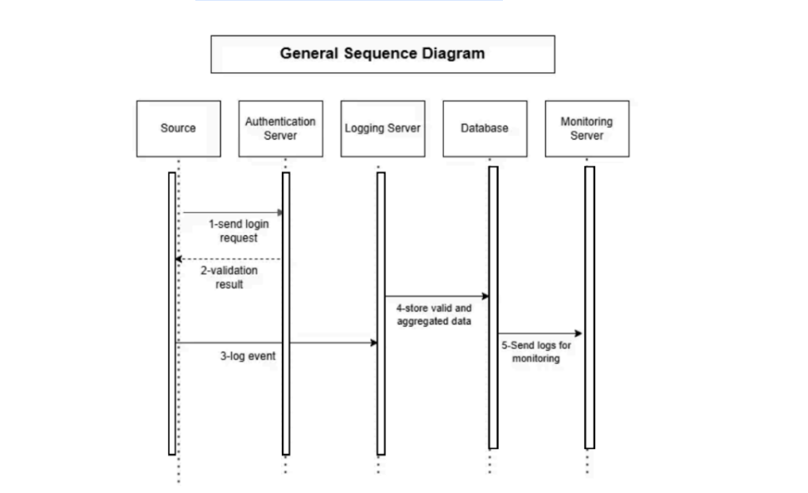
Sequence Diagram

Slide 8
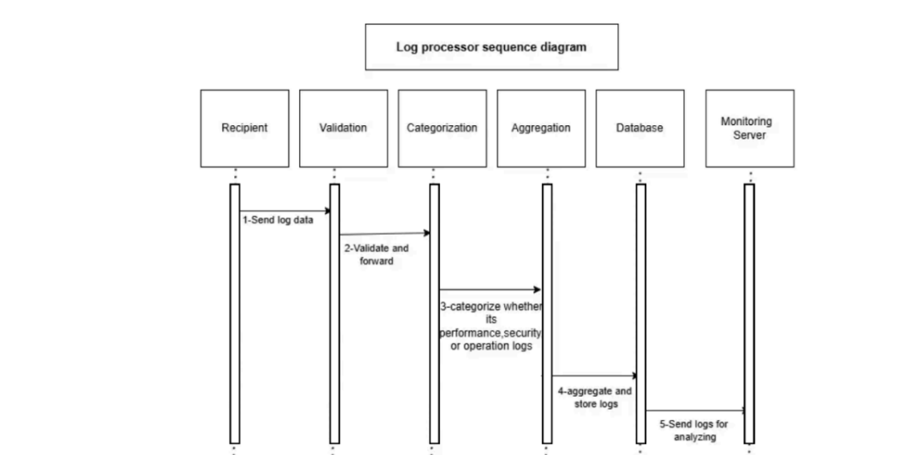

Slide 9
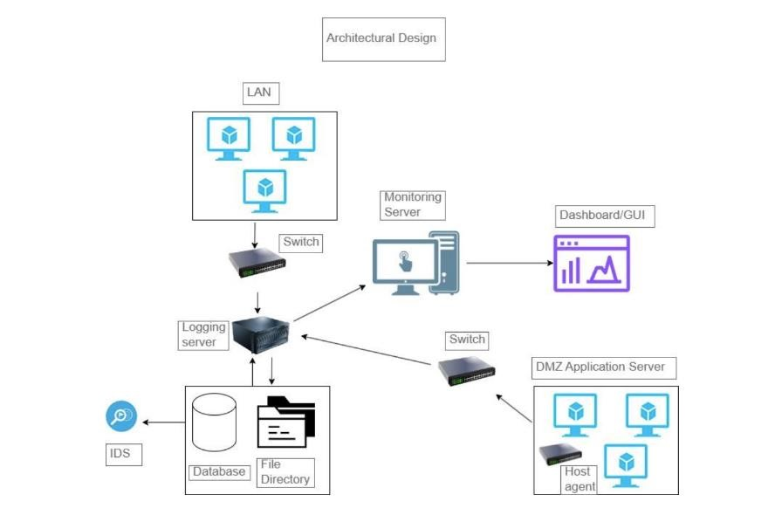
Architectural Design

Slide 10
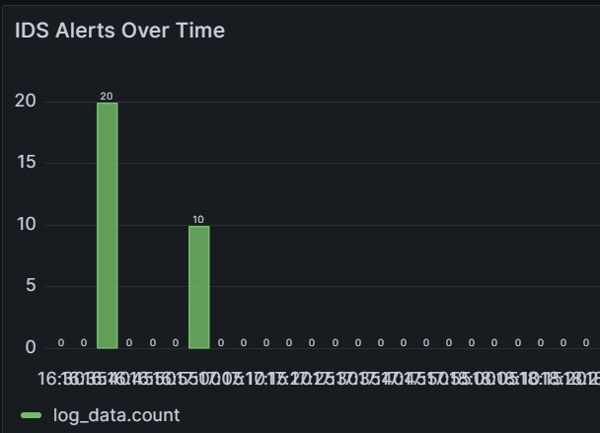
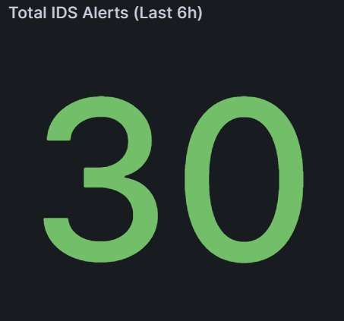
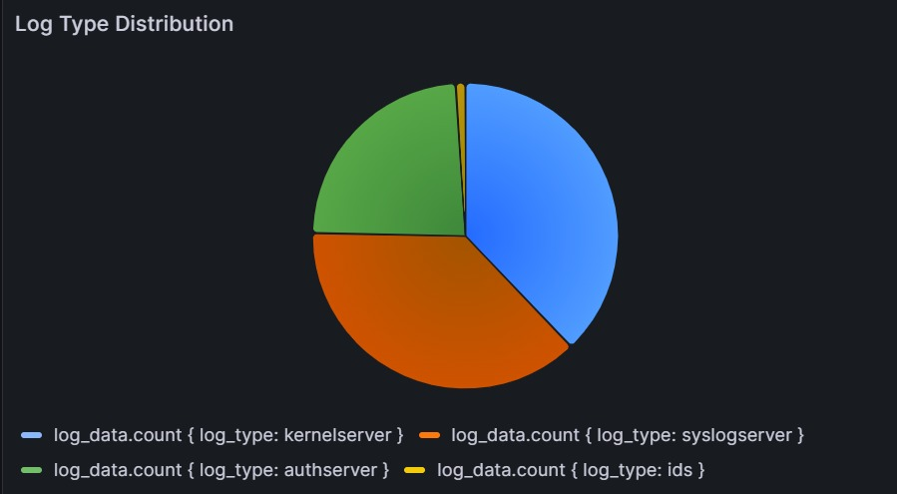
Dashboard Features
IDS Alerts Over Time
-Bar chart
-Statistics
-Pie chart
-Shows IDS alerts over a specific time and their count
-Total IDS alerts filtered by time
-Shows the log type rate and its source

Slide 11
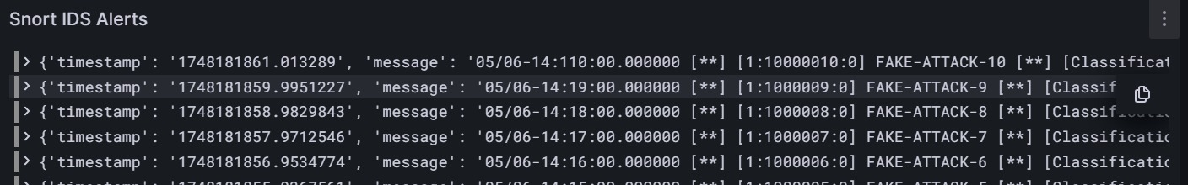
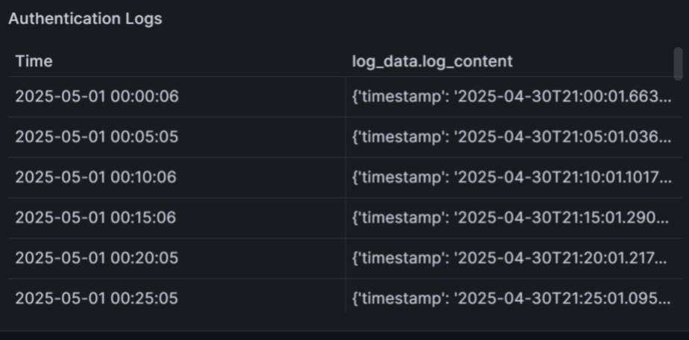
Dashboard Features
-Displays the IDS alerts and metadata of logs
-Displays the authentication logs and their metadata extracted from scripts

Slide 12
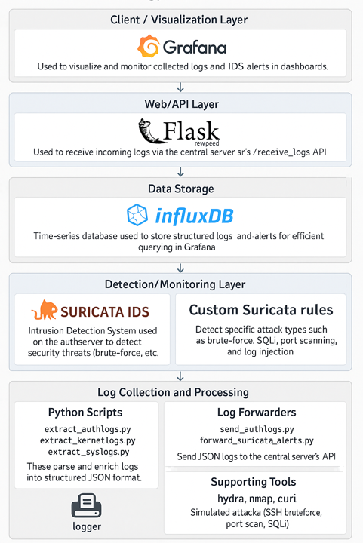
Technology Stack

Slide 13
Scenario of Demonstration
Access authentication server.
⁠Show how logs are structured and sent to the central server.
Run log forwarding script.
Simulate attacks.
Monitor real-time alerts in Grafana.

Slide 14
Conclusion
Our project’s main goal was to address logging issues in high-level organizations such as banks and other critical infrastructures. It successfully achieved the objectives by :
1-Building a lightweight logging system that is easy to use and manage.
2-Adding real-time monitoring by integrating Suricata to directly spot threats as they happen.
3-Centralizing logs from different servers in one main server.
4-Storing only important metadata from logs to save space and speed.
5-Create a simple user-friendly interface with clear panels to help SOC teams visualize alerts.

Slide 15
Thank You!

